Slide 1
EA – MAP583 Deep Learning
Reducing space complexity of audio classification models
Amaury Lancelin
Maxime Bonnin
Anđela Todorovic
Tutor : Adrei Bursuc

Slide 2
Agenda
Audio classification Framework
Pruning methods for resnet34 compression
Training a smaller model with the logits of resnet34

Slide 3
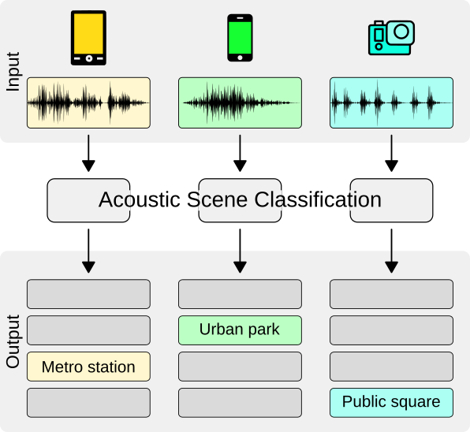


introduction
Part I
DCASE Task 1A
Low-Complexity Acoustic Scene Classification with Multiple Devices
10 classes : (airport, shopping mall, street traffic, bus,…)
Dataset : TAU Urban Acoustic Scenes (30Go + 8Go)
Choose a balanced subset (4Go) : 300 files/class
Examples of audio files in the dataset
Street pedestrian
Shopping mall

Slide 4

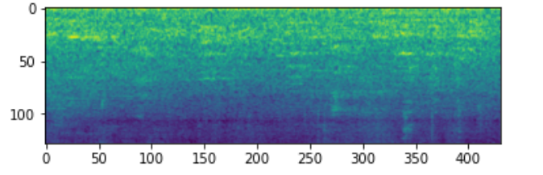
Framework
The idea is to transform the audio files into their Mel-spectrogram representation and then pass it to the CNN
Part I
CNN
Pr("airport") = 0.11
Pr("bus") = 0.67
Pr("metro") = 0.04
….
CNN model with a 1-channel first layer
Output : class proba
Input : audio files
Mel-spectrogram shape : 1x431x128

Slide 5
Agenda
Audio classification Framework
Pruning methods for resnet34 compression
Training a smaller model with the logits of resnet34

Slide 6
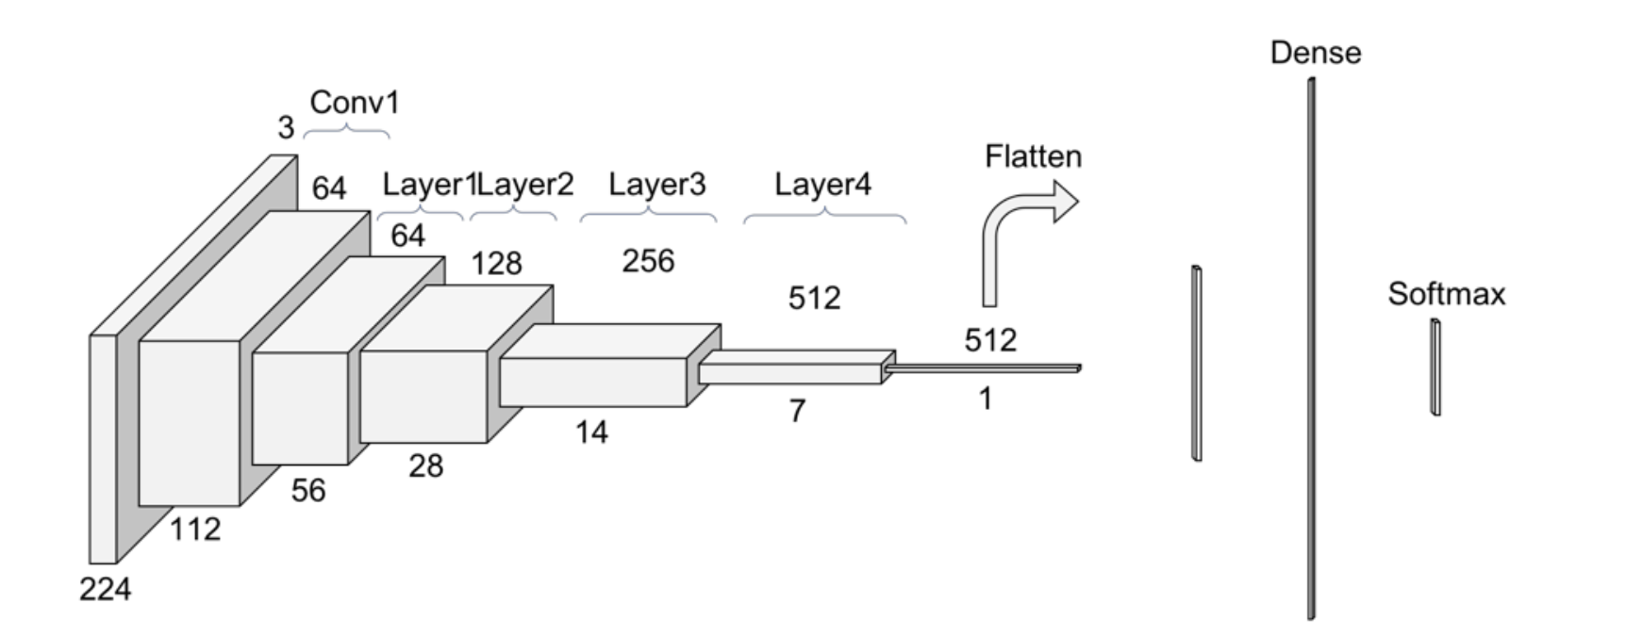
Pruning methods for Resnet34 compression
Part II
Approach to the audio classification task:
Using mel spectograms of each audio file (431 x 128 images)
Adjusting DCaseDataset and training manager to handle imagery data
Adapting first few layers of pretrained ResNet34 to handle our data
Training on down-stream task
Pr("airport") = 0.11
Pr("bus") = 0.67
Pr("metro") = 0.04

Slide 7
Pruning methods for Resnet34 compression
Part II
Inspiration:
Pruning filters with L1-norm and standard deviation for CNN compression (Sun et al., 2019)
J. Frankle & M. Carbin: The Lottery Ticket Hypothesis: Finding Sparse, Trainable Neural Networks (ICLR2019)
Idea:
Make the weight matrix sparse by pruning a percentage of weights with smallest L1 norm - iteratively
Results:
ResNet34: Accuracy -> 0.814 Total Trainable Params -> 21.4 M
Compressed: Accuracy -> 0.79 Total Trainable Params -> 22.1 K
Model with only 6.25% of the original weight matrix gives only 0.02 decrease in accuracy!

Slide 8
Agenda
Audio classification Framework
Pruning methods for resnet34 compression
Training a smaller model with the logits of resnet34

Slide 9
Training a smaller model with the logits of resnet34
Part III
Approach to the audio classification task:
Using mel spectograms of each audio file (431 x 128 images)
Precomputing the logits of the big model
Parameters: 62k vs 21.4M
Adjusting DCaseDataset and training manager to handle each approach :
Training on the logits of the big model
Training on true labels
Results:
True labels: final accuracy after 200 epochs 69.8%
Logits:
Final accuracy after 200 epochs 48.2%
Final accuracy after 300 epochs 52.1%

Slide 10
Conclusion

Slide 11
Conclusion
Conclusion
Pruning is very effective on our task
Finetuning a different architecture on Resnet34 logits get moderate results
It could be interesting to take for the smaller model the same type of architecture

